Slide 1

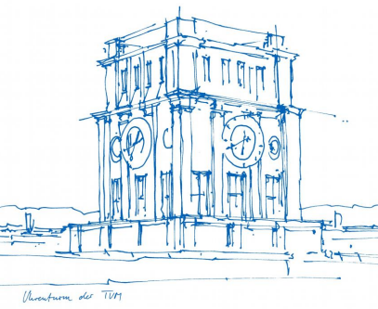
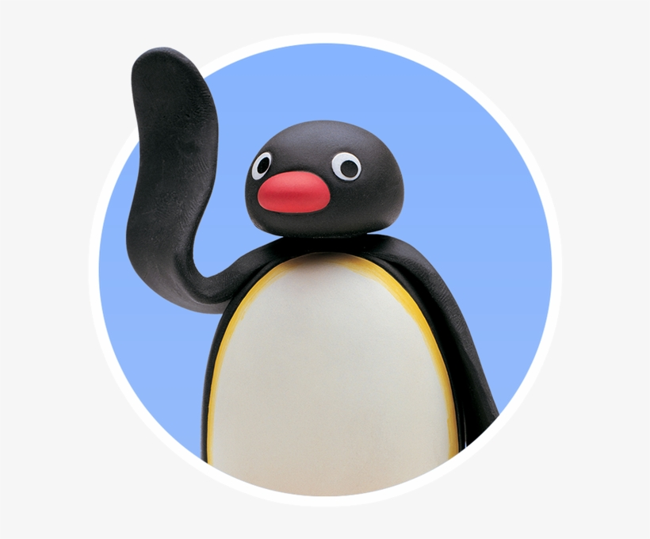
Interaction Prototyping
Lehrstuhl für Ergonomie TUM School of Engineering and Design Technical University of Munich
Milestone 3
The Rolling Penguins
Vincent Brunner Beatrice Seibert Stefano Ferrari
Winter Semester 2021/2022

Slide 2
Lehrstuhl für Ergonomie TUM School of Engineering and Design Technical University of Munich
Content
Design Language
Figma Prototype
User Test Report
Web App

Slide 3

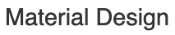
Lehrstuhl für Ergonomie TUM School of Engineering and Design Technical University of Munich
Google´s Design System
Intuitive user interaction with UI design
Figma Plug-In for Icons, Components and Theme builder
Users are familiar with design elements
Assures readability and accessibility (Font Size and Contrast)
Fundamentally user tested
Components and UI elements ready to use

Slide 4
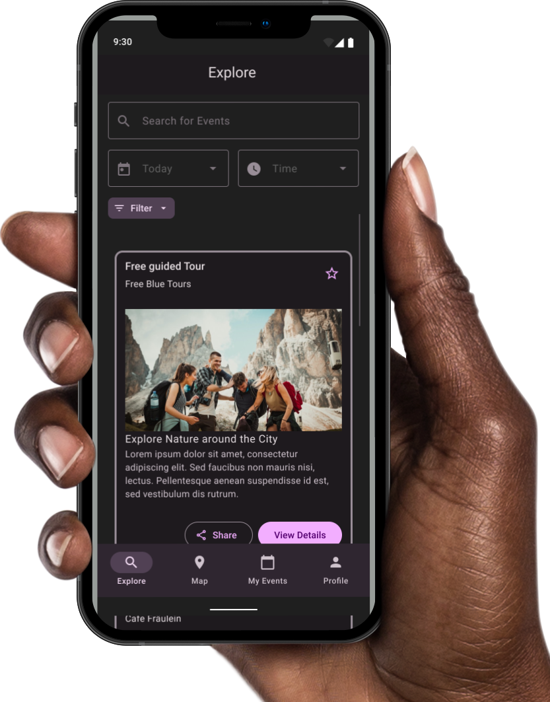
Lehrstuhl für Ergonomie TUM School of Engineering and Design Technical University of Munich
Event Finder -
HIFI Prototype

Slide 5
Lehrstuhl für Ergonomie TUM School of Engineering and Design Technical University of Munich
3. User Test Report
- User tests
- Evaluation with Figma prototype
- User Guideline: - Find and save an event with the explore option - Find and save an event with the maps option
Notes:
1-2 screens darstellen, damit klar ist über was gesprochen wird
Paar positives Feedback / Dinge sagen: Navigation (Nav bar ist nicht mehr verwirrend

Slide 6
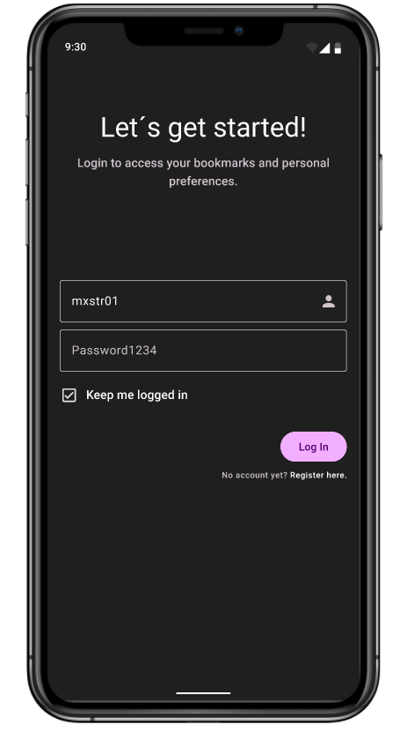
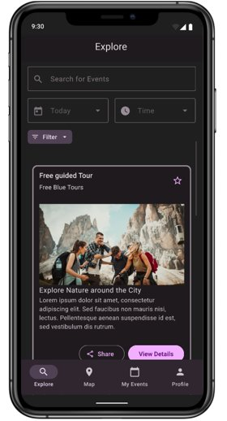
Lehrstuhl für Ergonomie TUM School of Engineering and Design Technical University of Munich
3. User Test Report

Slide 7
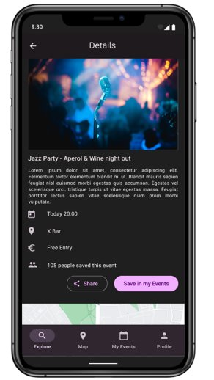
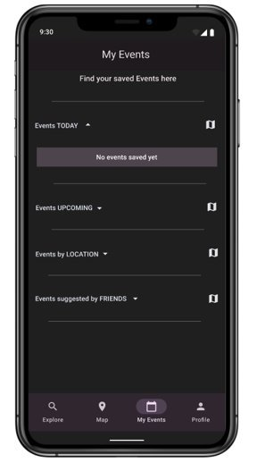
Lehrstuhl für Ergonomie TUM School of Engineering and Design Technical University of Munich
3. User Test Report

Slide 8
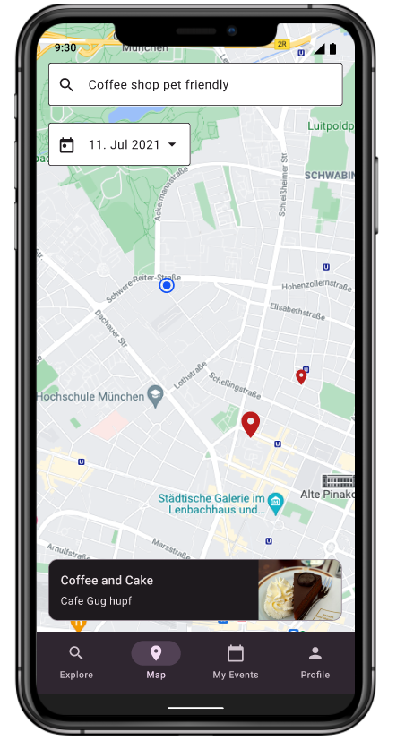
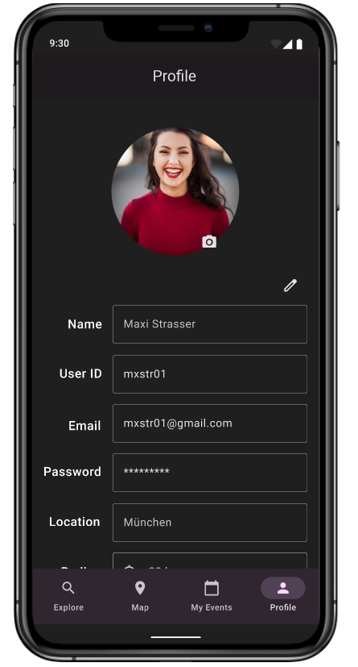
Lehrstuhl für Ergonomie TUM School of Engineering and Design Technical University of Munich
3. User Test Report

Slide 9

Lehrstuhl für Ergonomie TUM School of Engineering and Design Technical University of Munich
Web-App with Angular
TypeScript-based front-end framework
Open source software developed by Google
Dynamic loading and asynchronous compilation of templates
Modularity principle
Pre-defined Material design components
→ https://angular.io

Slide 10
Lehrstuhl für Ergonomie TUM School of Engineering and Design Technical University of Munich
Web-App with Angular
EventFinder App https://interactionprototyping.github.io/WS2022_RollingPenguins
Material Design Components https://material.angular.io/components/
Googe Font Icons https://fonts.google.com/icons?icon.query=location
Google Maps Component
Tutorial: https://timdeschryver.dev/blog/google-maps-as-an-angular-component
Component: @angular/google-maps

Slide 11
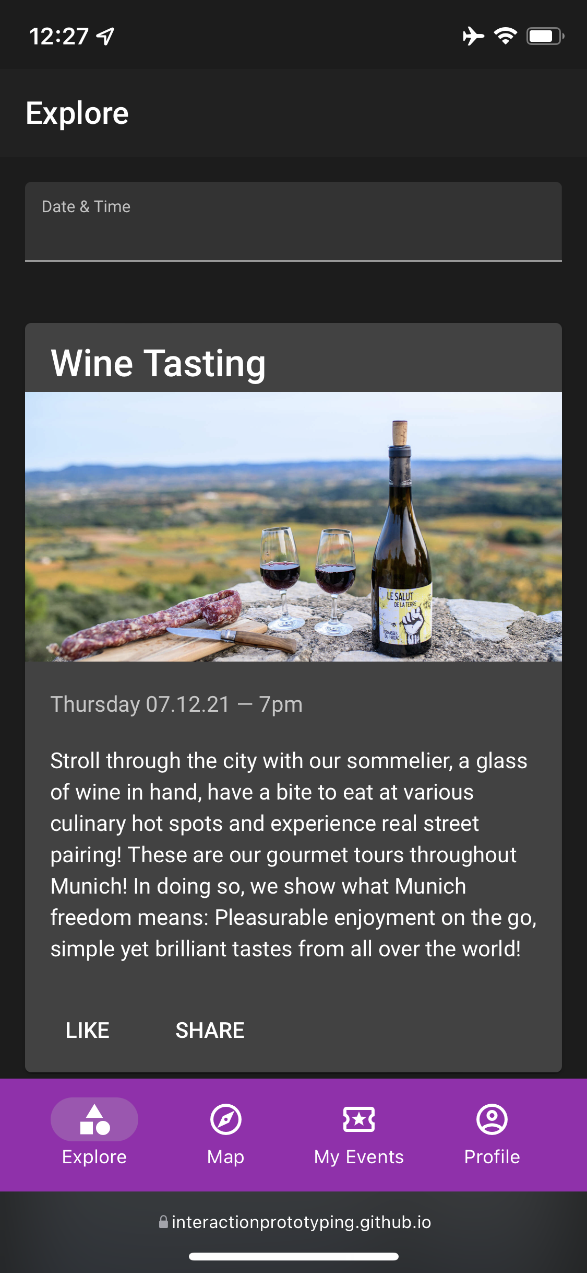
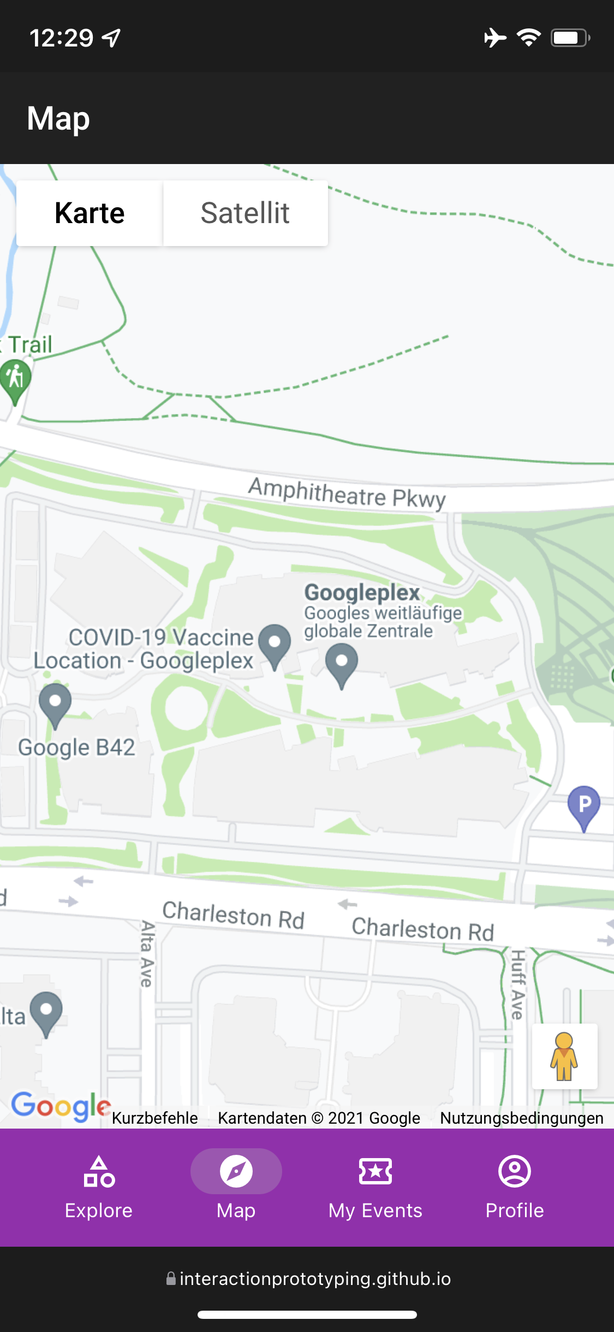
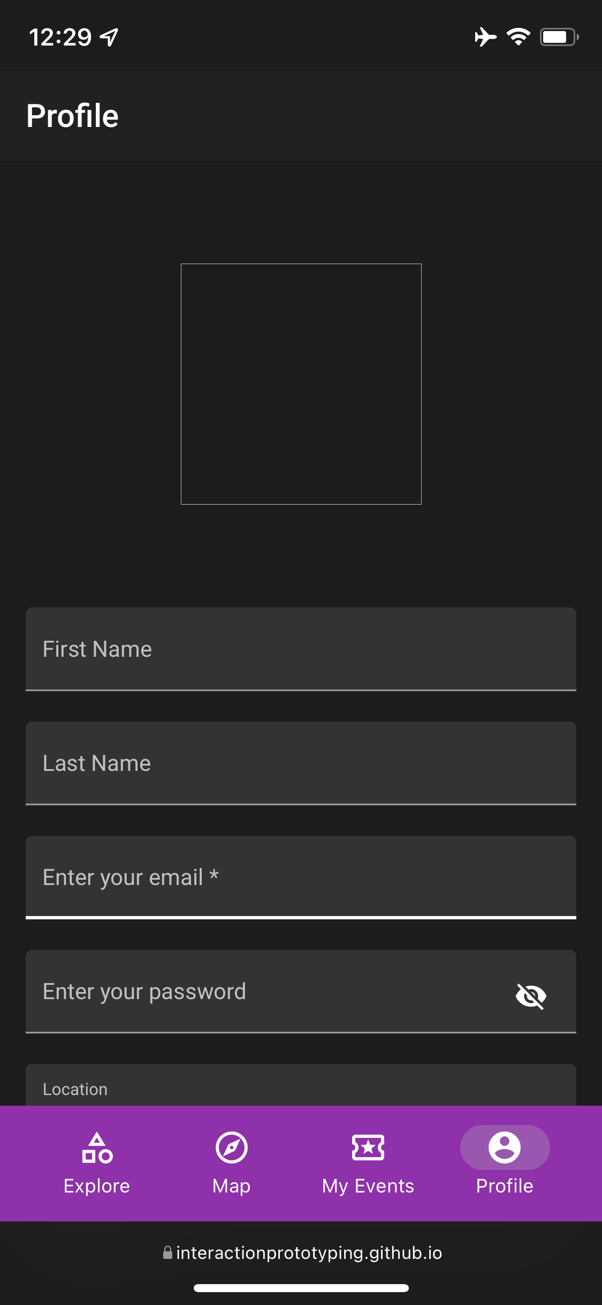
Lehrstuhl für Ergonomie TUM School of Engineering and Design Technical University of Munich

Slide 12

Lehrstuhl für Ergonomie TUM School of Engineering and Design Technical University of Munich
Thank you for your attention!
… any questions?

Slide 13
Lehrstuhl für Ergonomie TUM School of Engineering and Design Technical University of Munich
Further Links and Readings
Google. (n. d.). Angular. Angular. Abgerufen am 15. Dezember 2021, von https://angular.io
Google. (n. d.). Material Design 3. Material Design. Abgerufen am 15. Dezember 2021, von https://m3.material.io
Google. (n. d.). Text legibility. Material Design. Abgerufen am 15. Dezember 2021, von https://material.io/design/color/text-legibility.html#text-backgrounds
Interaction Design Foundation. (n. d.). Flat Design. Abgerufen am 15. Dezember 2021, von https://www.interaction-design.org/literature/topics/flat-design

